Slide 1
Reliability and Validity of smartphone-based cognitive-motivational experiments in alcohol use order
Figures

Slide 2
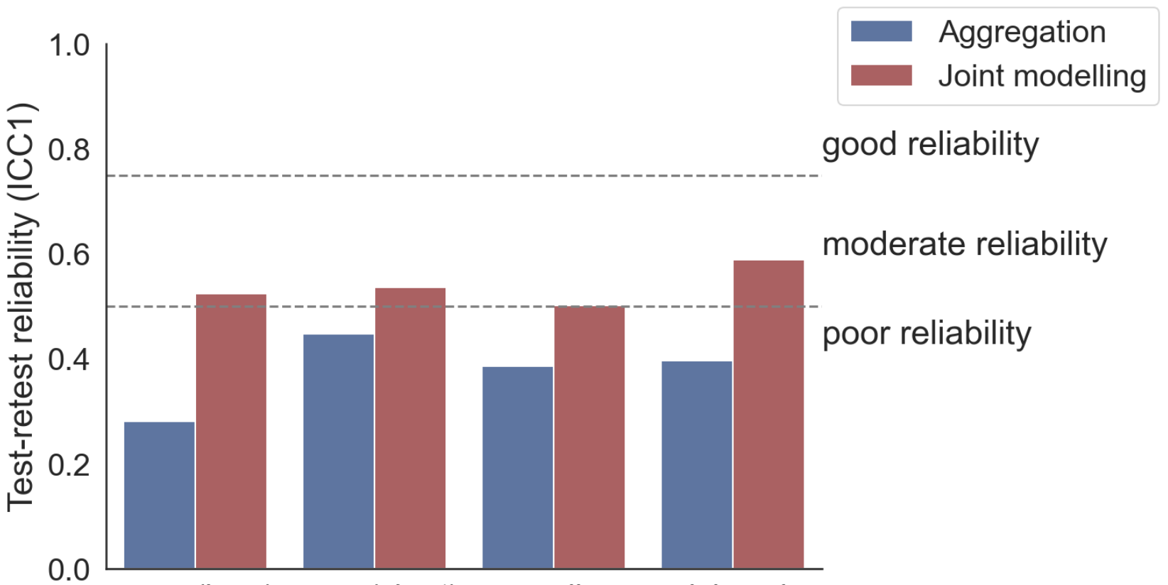
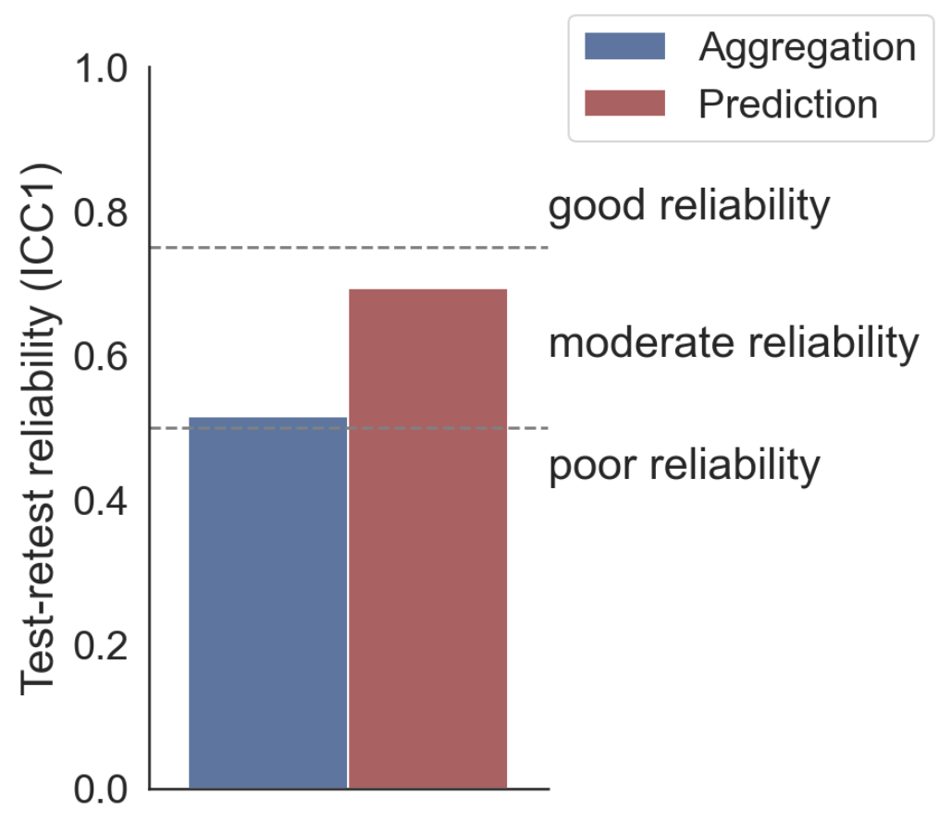
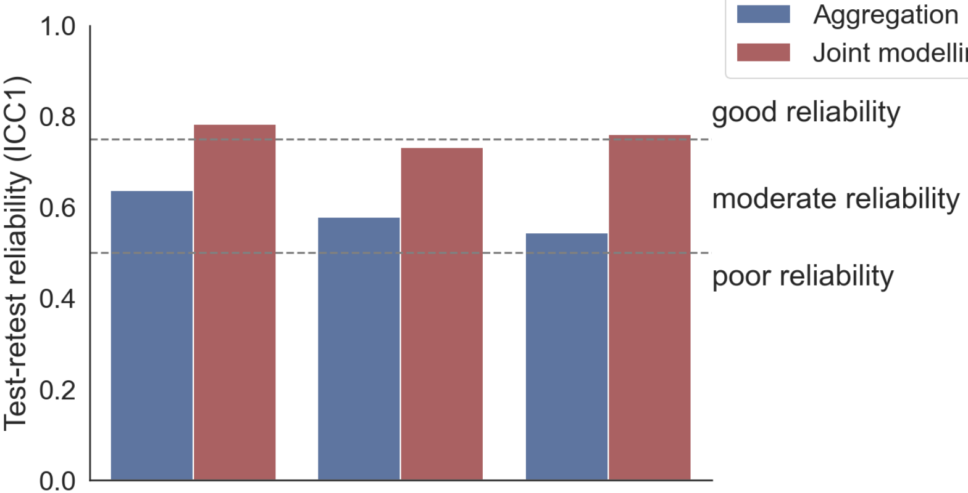
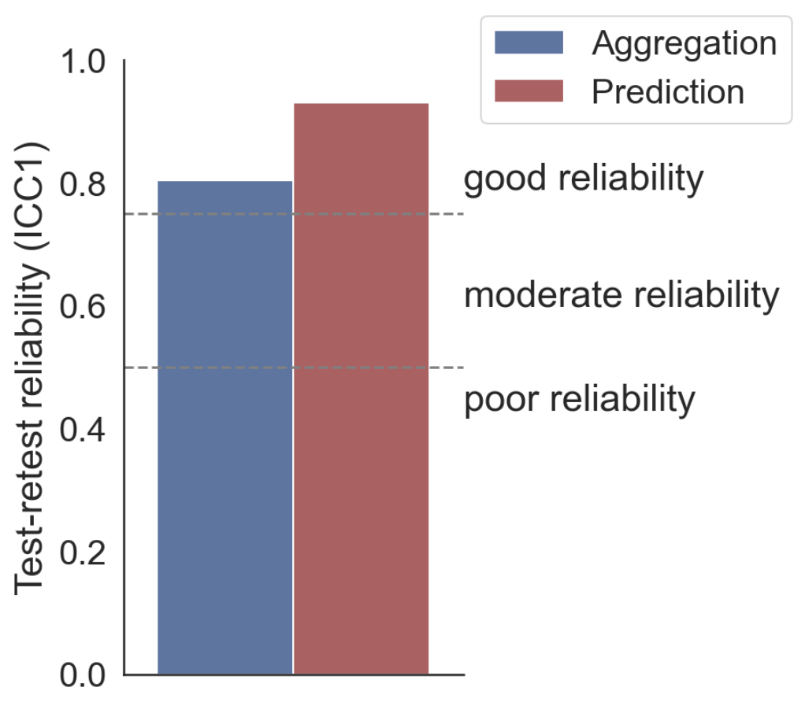
A: Working memory task
B: Stop signal task
no (long)
no (short)
encoding
delayed
SSRT
C: Risk taking task
D: Information sampling task
win
loss
mixed
oversampling

Slide 3
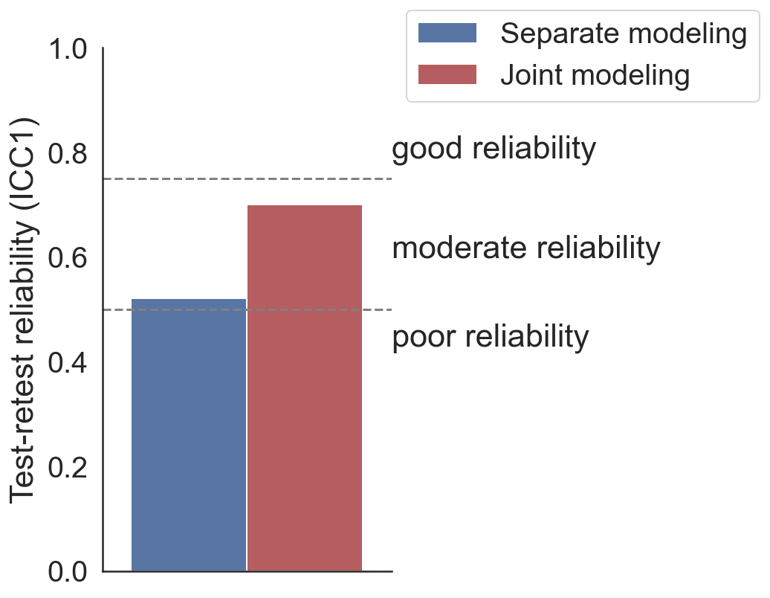
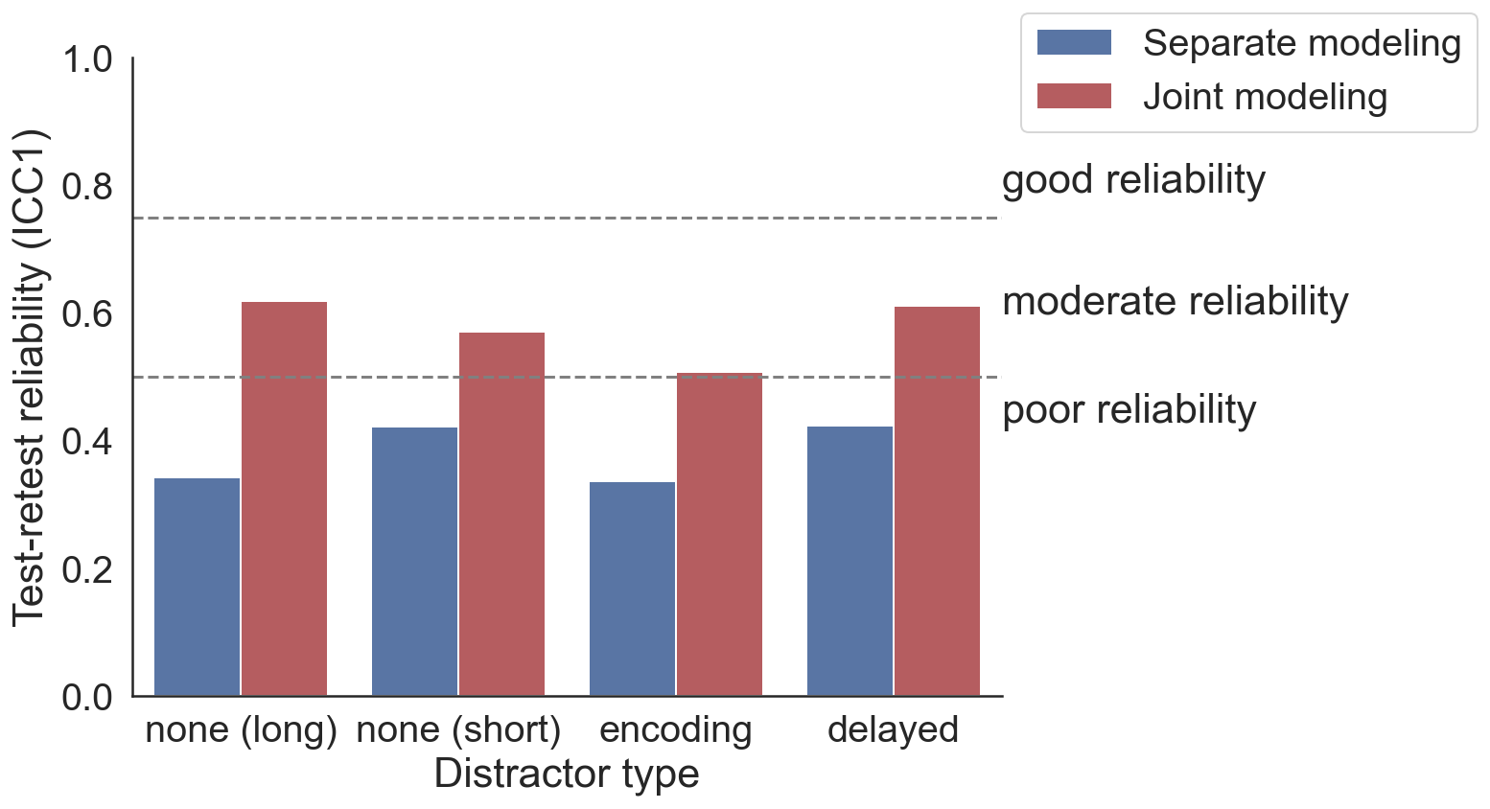
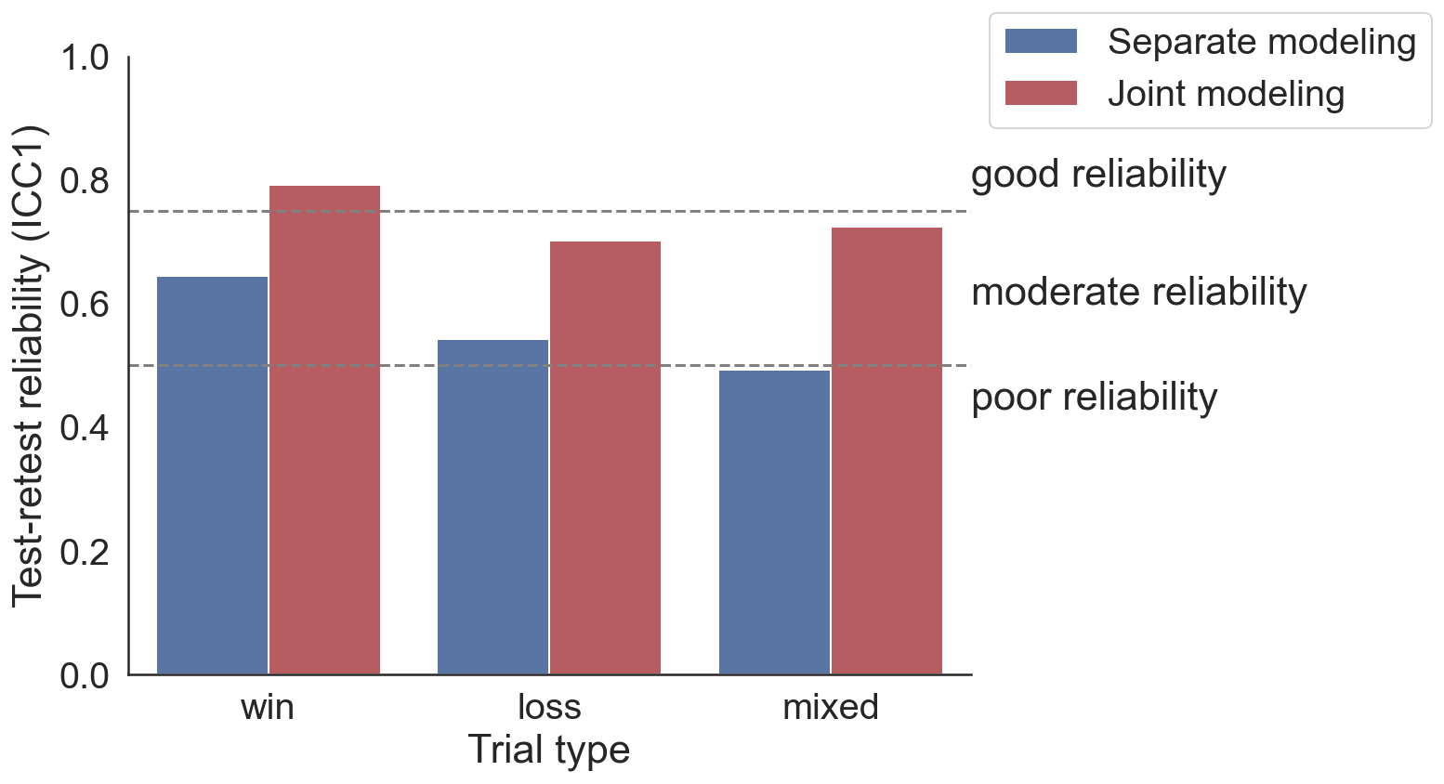
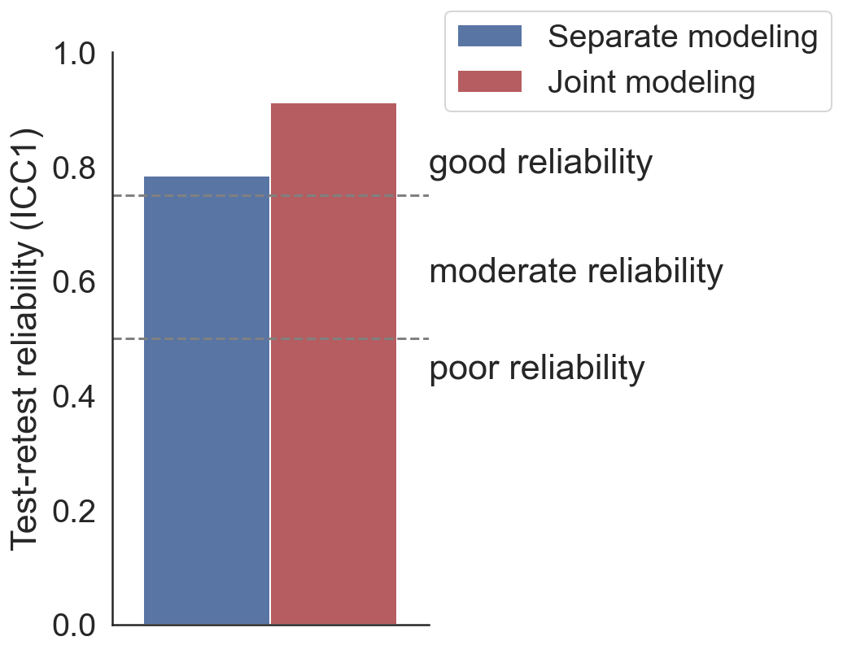
A: Inhibition task
B: Working memory task
SSRT
no (long)
no (short)
encoding
delayed
C: Risk taking task
D: Information sampling task
win
loss
mixed
sampling bias

Slide 4
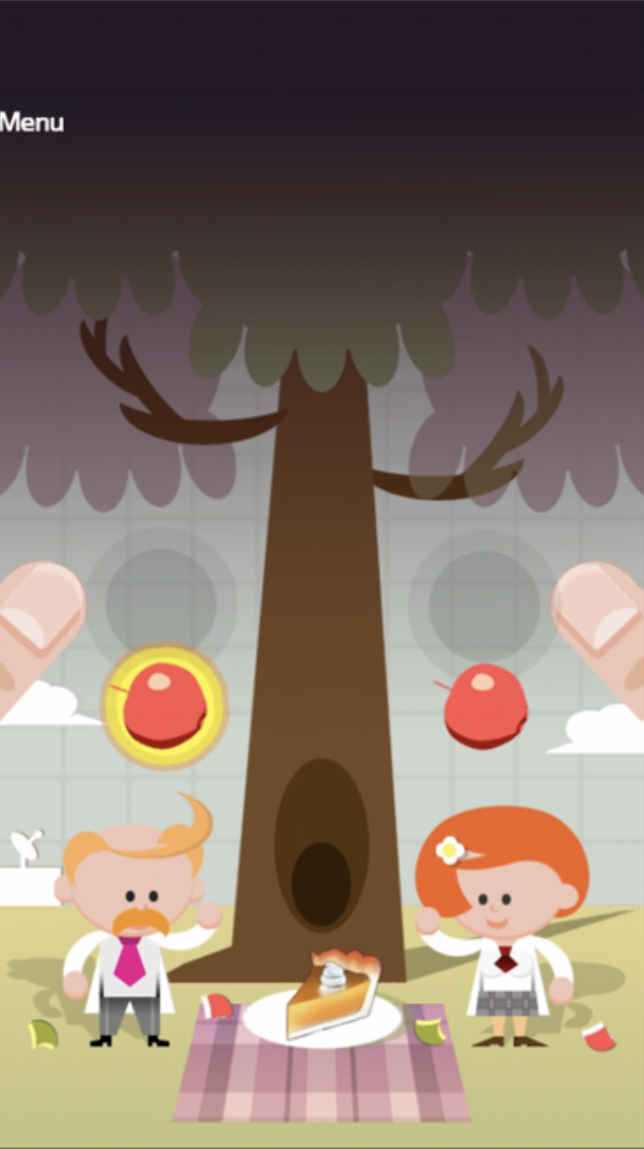
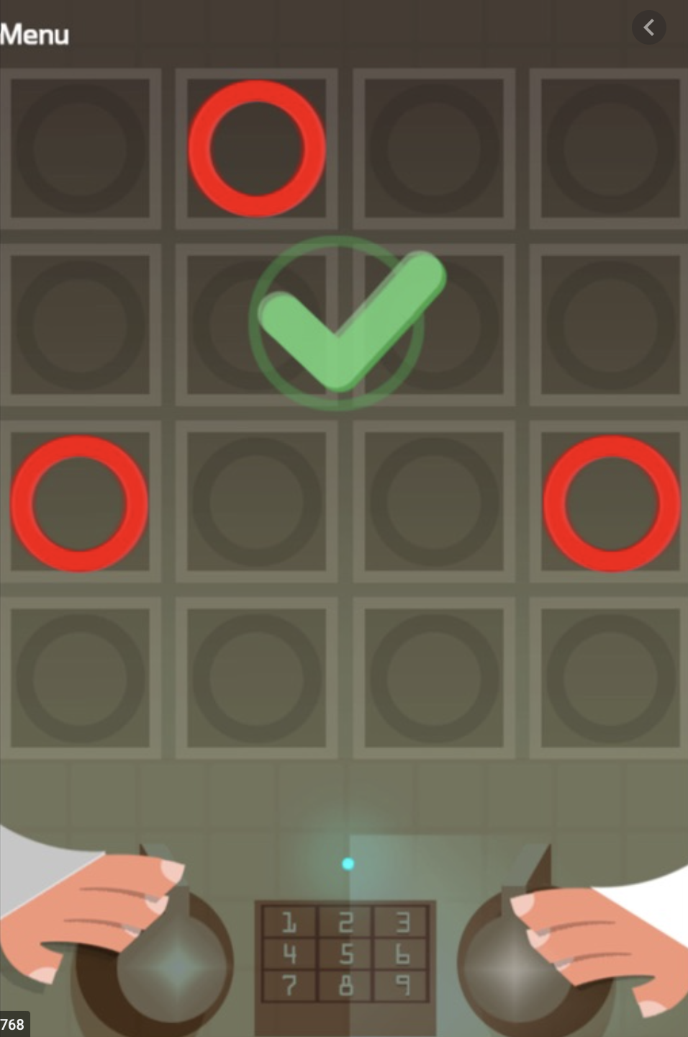
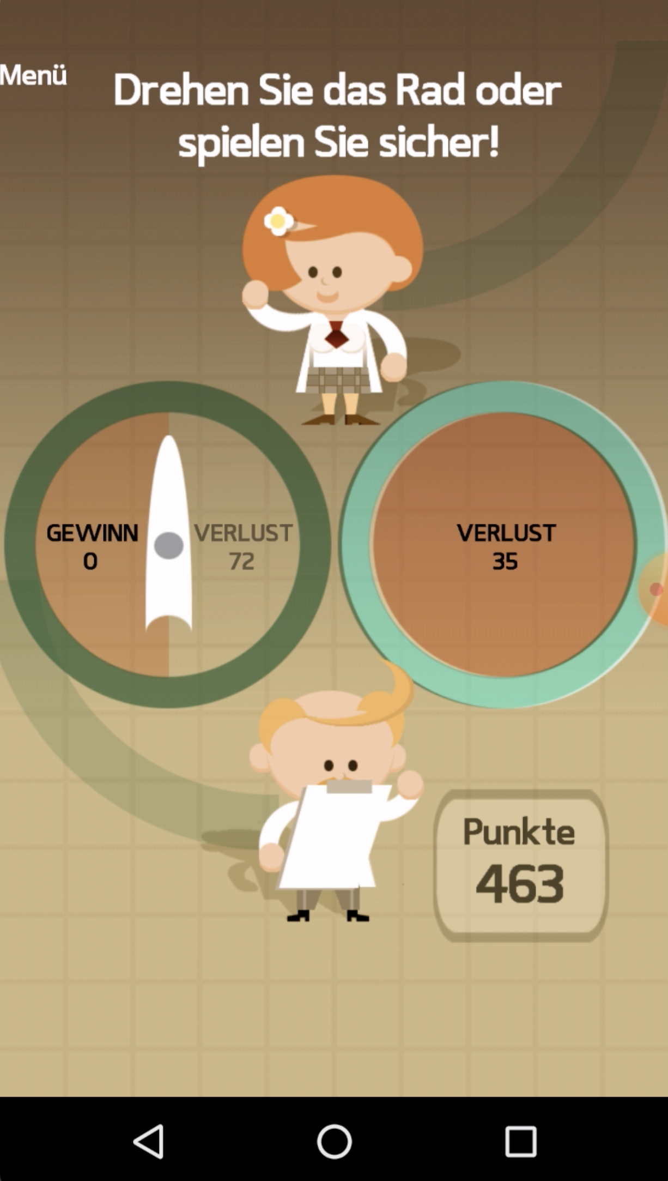
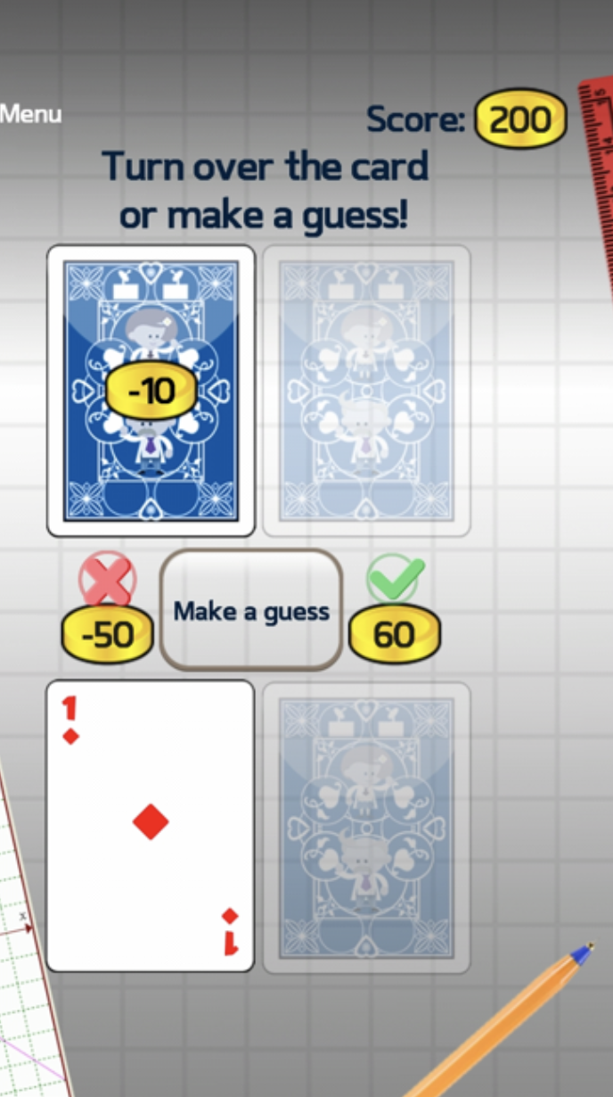
A: Response inhibition
B: Working memory
C: Risk taking
D: Information sampling

Slide 5
A: Response inhibition
B: Working memory
C: Risk taking
D: Information sampling
2 Baseline measurements
Day 1
Day 365
Retrospective drinking questions
App installation

Slide 6
A: Response inhibition
B: Working memory
C: Risk taking
D: Information sampling
ca. 20 min
…
Home (following Monday)
Laboratory (day 1)
Diagnostics to check SUD
App installation
Two baseline measurements

Slide 7
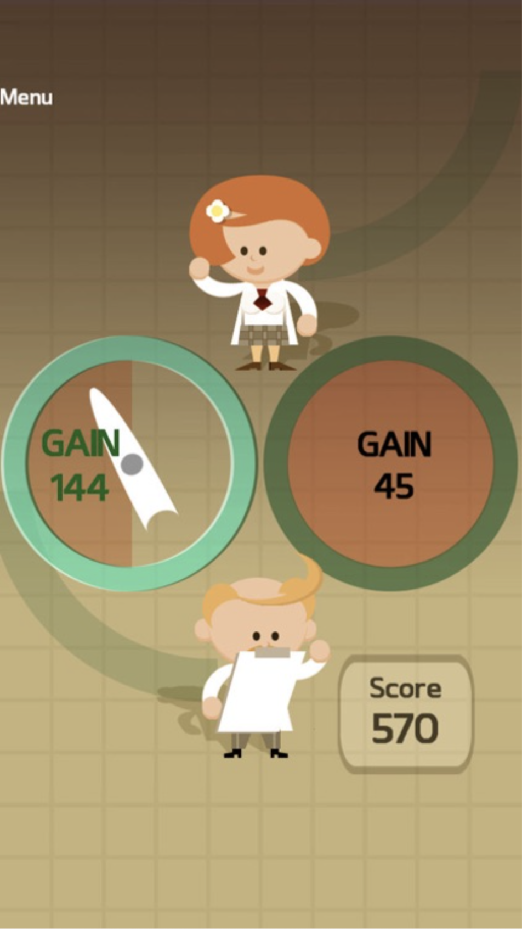
Response inhibition
B: Working memory
C: Risk taking
D: Information sampling
Laboratory (day 1)
At home (following Monday)
Diagnostics
App installation
Two measurements

Slide 8
Response inhibition
Working memory
Risk taking
Information sampling
Laboratory (day 1)
At home (following Monday)
Diagnostics
App installation
Two measurements

Slide 9
Response inhibition
Working memory
Risk taking
Information sampling
Laboratory (day 1)
At home (following Monday)
Diagnostics
App installation
Two measurements

Slide 10
Response inhibition
Working memory
Risk taking
Information sampling
Laboratory (day 1)
At home (following Monday)
Diagnostics
App installation
Two measurements

Slide 11
Response inhibition
Working memory
Risk taking
Information sampling
Laboratory (day 1)
At home (following Monday)
Diagnostics
App installation
Two measurements

Slide 12

Diagnostics
Response inhibition
Working memory
Risk taking
Information sampling
Laboratory:
Diagnostics
Field:
Task measures (2X)

Slide 13
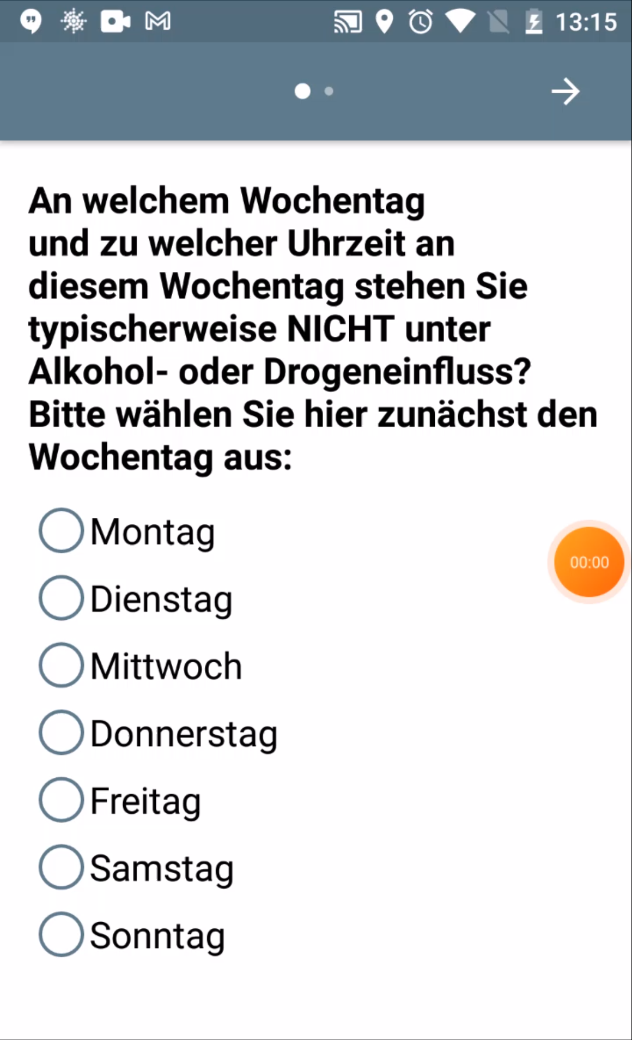
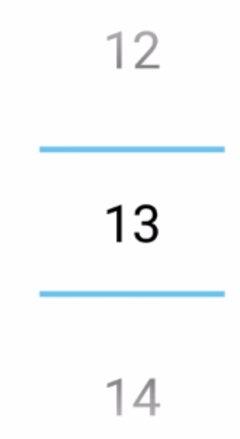
A: Stop signal
B: Working memory
C: Risk taking
D: Information sampling
D: Information sampling
Think about yesterday. Which and how many drinks did you consume?
Small beers (0.2L)
Medium beers (0.33L)
…
…
Day 1
first Monday
every 2 days
4-weekly
Day 365
Retrospective drinking questions
Two baseline GBEs
EMA drinking questions
One EMA GBE

Slide 14
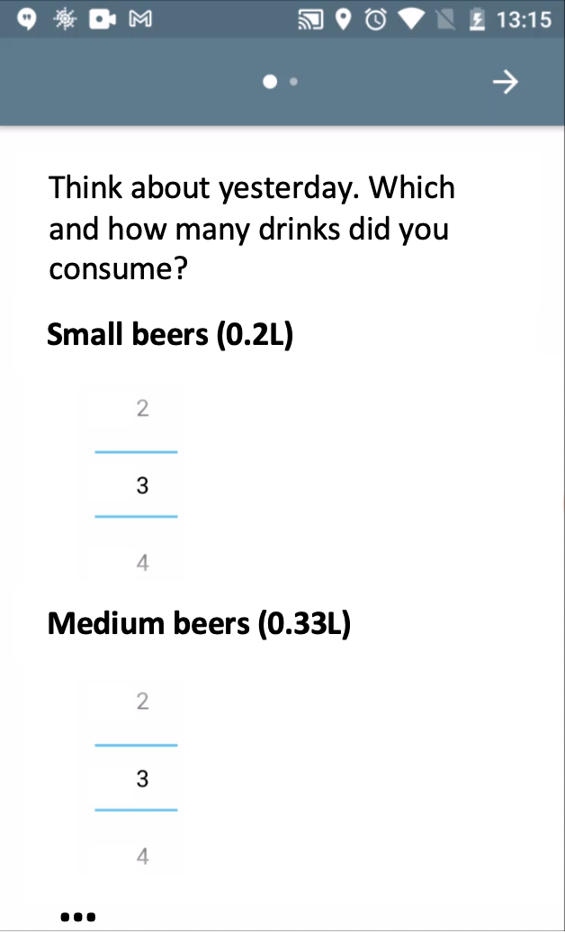
A: Stop signal
B: Working memory
C: Risk taking
D: Information sampling
E: EMA Drinking questions
F: Timeline
…
Day 1
first Monday
every 2 days
every 4 weeks
1 Year
Retrospective drinking questions
Two baseline GBEs
EMA drinking questions
One EMA GBE

Slide 15
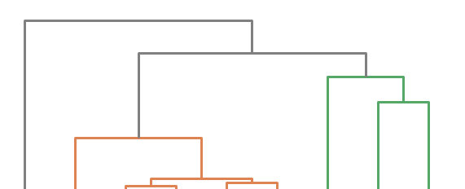
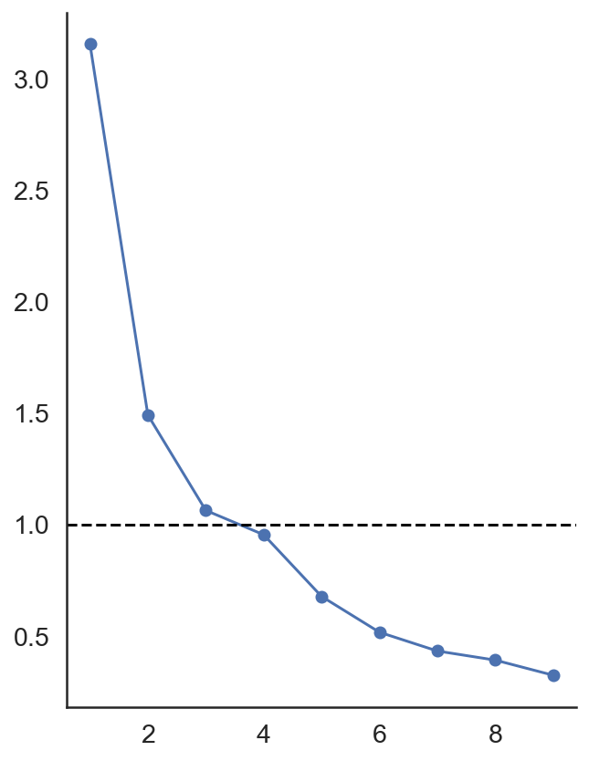
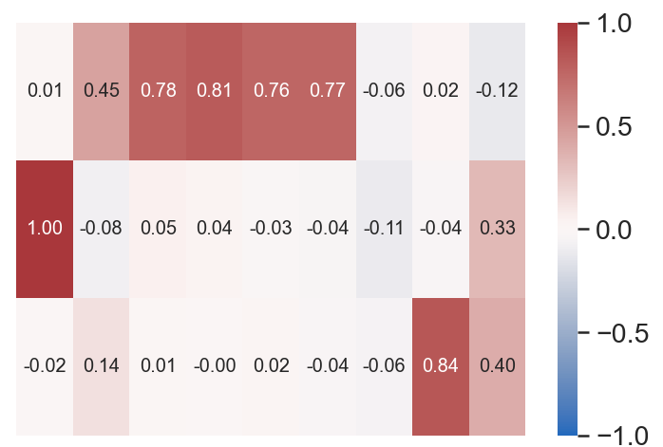
A: Scree plot
B: Factor loadings and clustering
Executive
control
Eigenvalue
Risk taking
(loss)
Factor loading
Risk taking
(win)
Number of factors
RTT (loss)
WM (short)
SSRT
RTT (mixed)
WM (encoding)
RTT (win)
WM (delayed)
Sampling bias
WM (long)

Slide 16
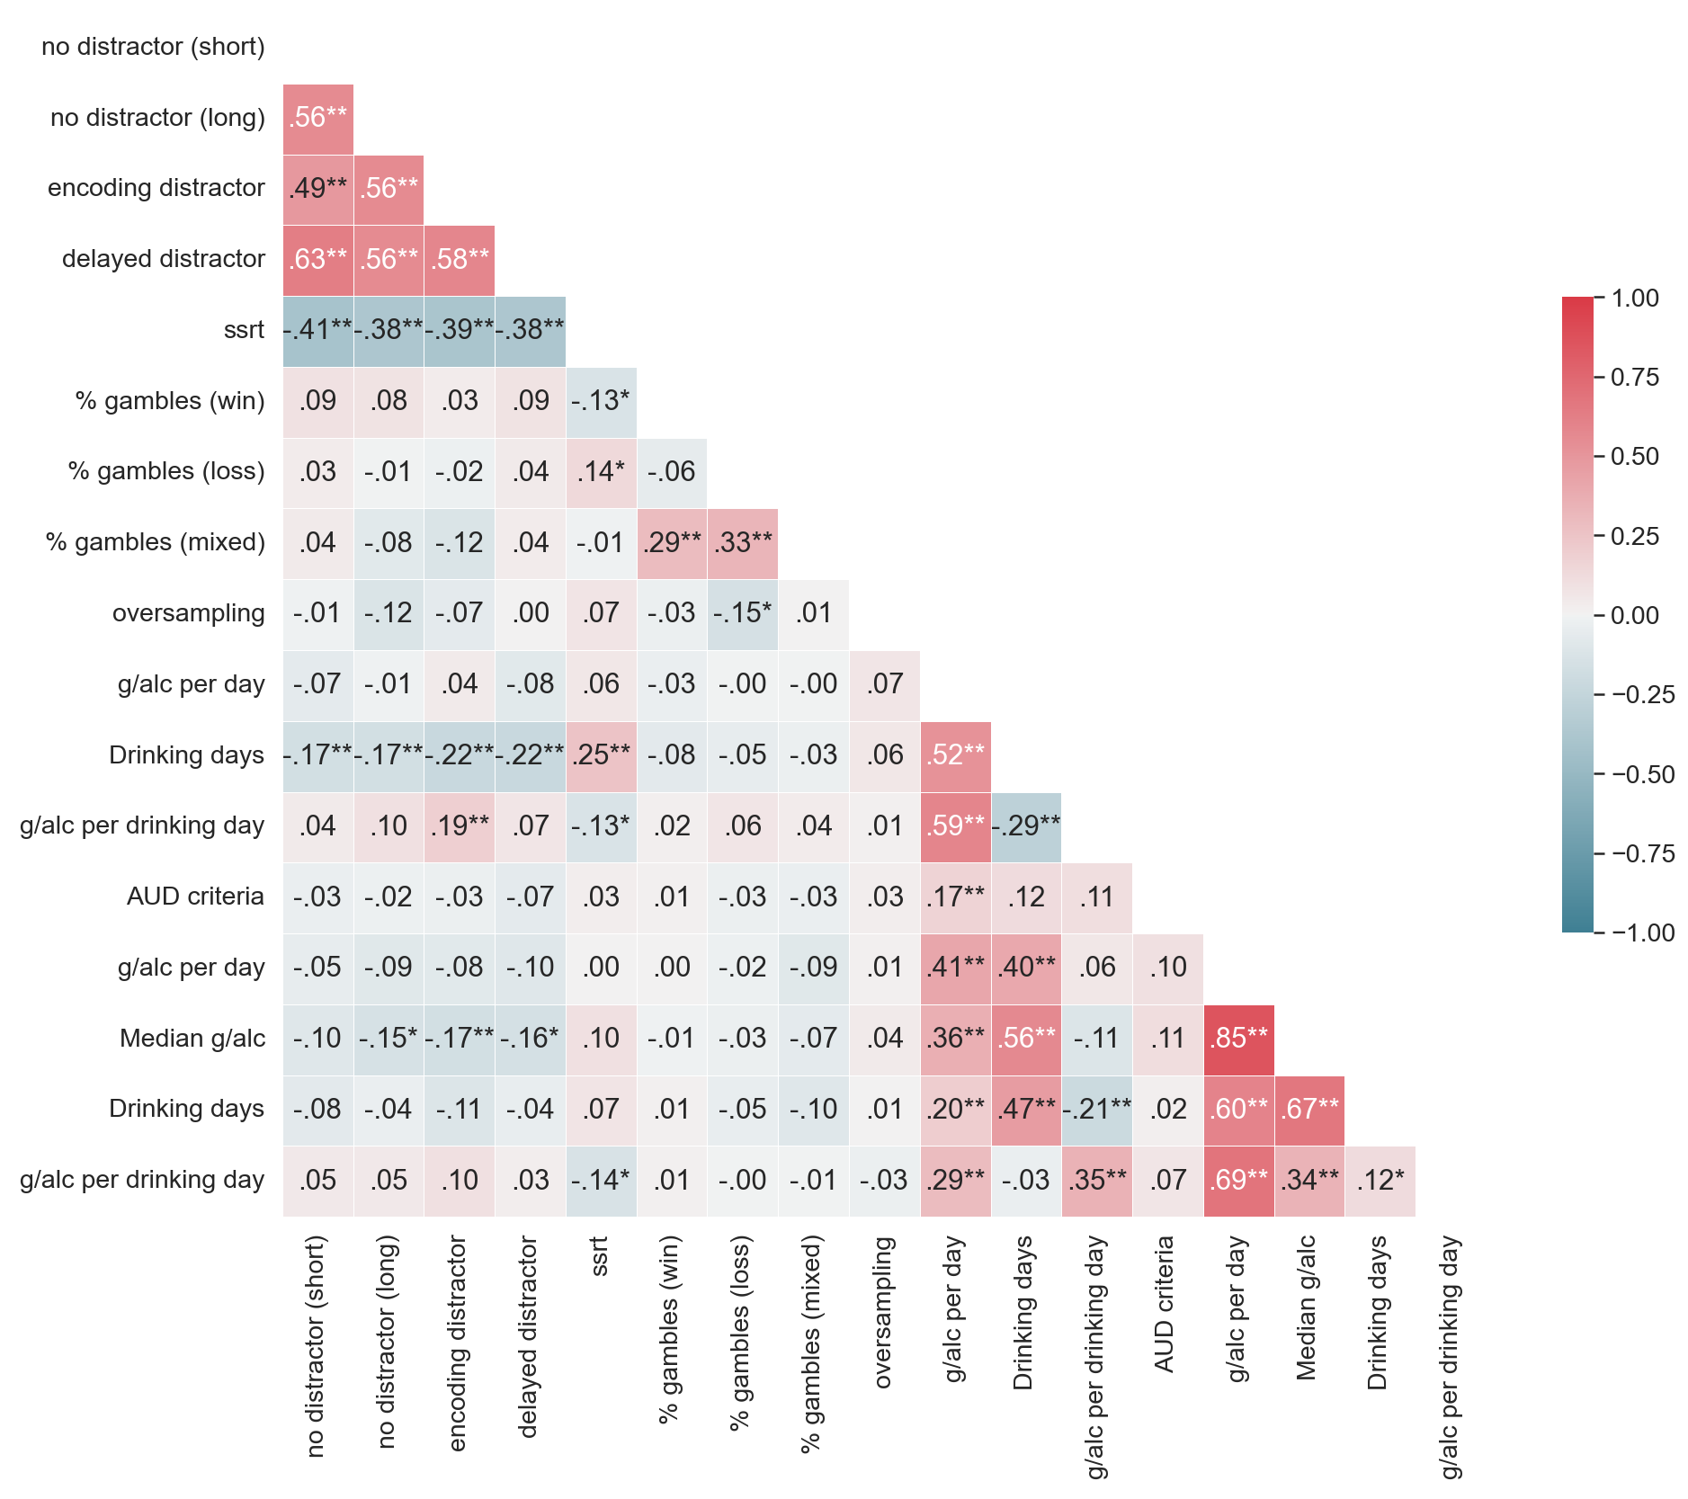
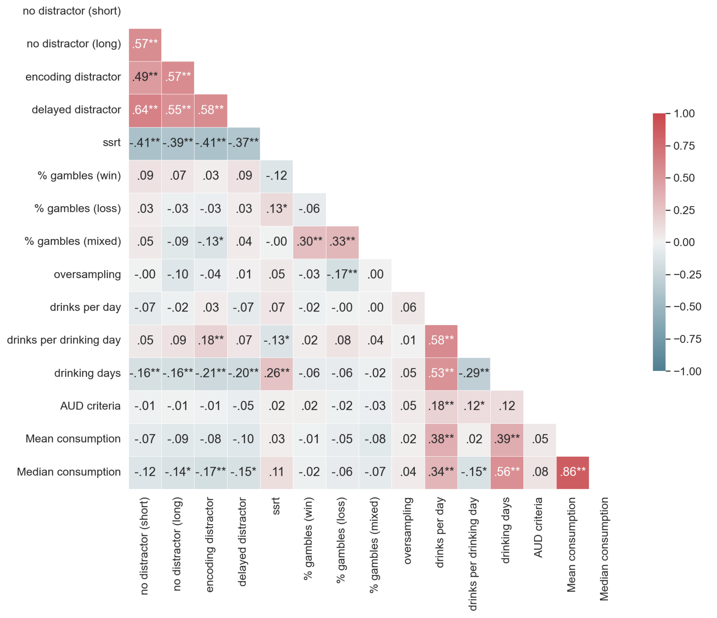
Working
memory
Inhibition
Risk taking
Information
sampling
Retrospective
drinking
AUD criteria
EMA drinking
Notes:
This is the definitive version

Slide 17
Working
memory
Inhibition
Risk taking
Information
sampling
Retrospective
drinking
AUD criteria
EMA drinking

Slide 18
Working memory
Working
memory
Inhibition
Risk taking
Inhibition
Risk taking
Information
sampling
Retrospective
drinking
AUD criteria
EMA drinking

Slide 19
No distractor (short)
Working
memory
No distractor (long)
Encoding distractor
Delayed distractor
Inhibition
SSRT
% gambles (win)
Risk taking
% gambles (loss)
% gambles (mixed)
Information
sampling
Oversampling
Drinks per day
Retrospective
drinking
Drinks per drinking day
Drinking days
AUD criteria
AUD criteria
mean alcohol
consumption
EMA drinking
median alcohol
consumption

Slide 20
No distractor (short)
Working
memory
No distractor (long)
Encoding distractor
Delayed distractor
Inhibition
SSRT
% gambles (win)
Risk taking
% gambles (loss)
% gambles (mixed)
Information
sampling
Oversampling
Drinks per day
Retrospective
drinking
Drinks per drinking day
Drinking days
AUD criteria
AUD criteria
mean alcohol
consumption
EMA drinking
median alcohol
consumption

Slide 21
No distractor (short)
Working
memory
No distractor (long)
Encoding distractor
Delayed distractor
Inhibition
SSRT
% gambles (win)
Risk taking
% gambles (loss)
% gambles (mixed)
Information
sampling
Oversampling
Drinks per day
Retrospective
drinking
Drinks per drinking day
Drinking days
AUD criteria
AUD criteria
mean alcohol
consumption
EMA drinking
median alcohol
consumption

Slide 22
No distractor (short)
Working
memory
No distractor (long)
Encoding distractor
Delayed distractor
Inhibition
SSRT
% gambles (win)
Risk taking
% gambles (loss)
% gambles (mixed)
Information
sampling
Oversampling
Drinks per day
Retrospective
drinking
Drinks per drinking day
Drinking days
AUD criteria
AUD criteria
mean alcohol
consumption
EMA drinking
median alcohol
consumption

Slide 23
Working
memory
No distractor (long)
Encoding distractor
Delayed distractor
Inhibition
SSRT
% gambles (win)
Risk taking
% gambles (loss)
% gambles (mixed)
Information
sampling
Oversampling
Drinks per day
Retrospective
drinking
Drinks per drinking day
Drinking days
AUD criteria
AUD criteria
mean alcohol
consumption
EMA drinking
median alcohol
consumption

Slide 24
No distractor (short)
No distractor (long)
Working
memory
Encoding distractor
Delayed distractor
SSRT
Inhibition
% gambles (win)
% gambles (loss)
Risk taking
% gambles (mixed)
Oversampling
Information
sampling
Drinks per day
Drinks per drinking day
Retrospective
drinking
Drinking days
AUD criteria
AUD criteria
mean alcohol
consumption
EMA drinking
median alcohol
consumption

Slide 25
No distractor (short)
No distractor (long)
Encoding distractor
Working
memory
Delayed distractor
SSRT
% gambles (win)
Inhibition
% gambles (loss)
% gambles (mixed)
Risk taking
Oversampling
Drinks per day
Information
sampling
Drinks per drinking day
Drinking days
Retrospective
drinking
AUD criteria
mean alcohol
consumption
AUD criteria
median alcohol
consumption
EMA drinking

Slide 26
Working memory
Inhibition
Risk taking
Information sampling
Retrospective drinking
AUD criteria
EMA drinking

Slide 27
Working memory
Inhibition
Risk taking
Information sampling
Retrospective drinking
AUD criteria
EMA drinking

Slide 28
Working memory
Inhibition
Risk taking
Information sampling
Retrospective drinking
AUD criteria
EMA drinking

Slide 29
Working memory
Inhibition
Risk taking
Information sampling
Retrospective drinking
AUD criteria
EMA drinking

Slide 30
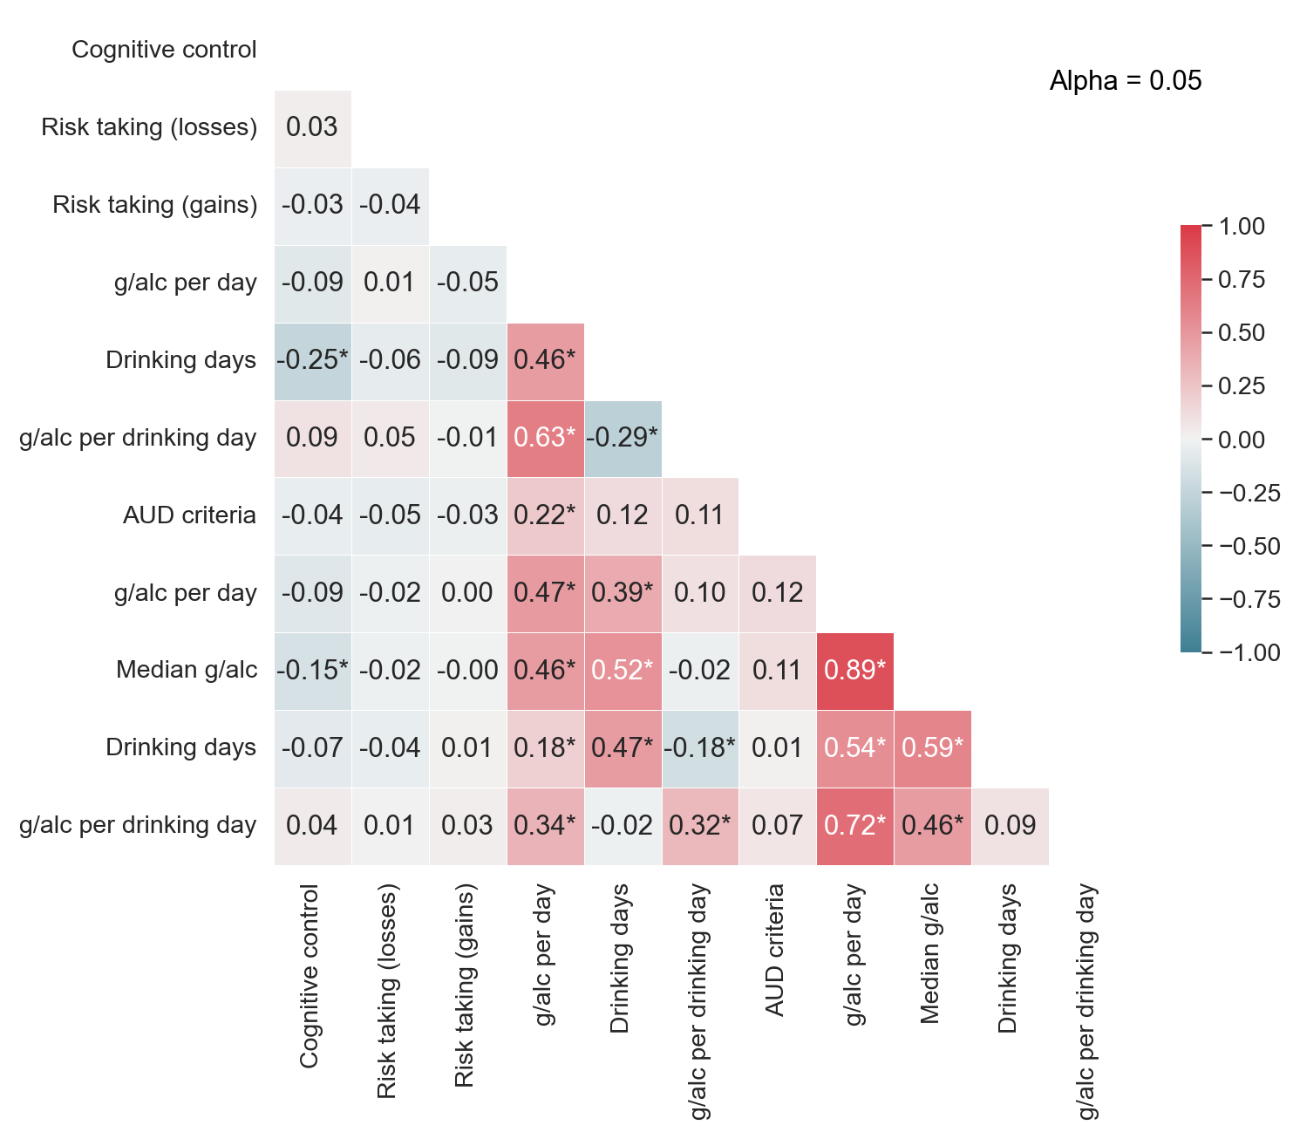
Pearson correlation
* p < .05
Experimental task factors
Retrospective drinking
AUD criteria
EMA drinking

Slide 31
Spearman correlation
* p < .005
Experimental task factors
Retrospective drinking
AUD criteria
EMA drinking

Slide 32
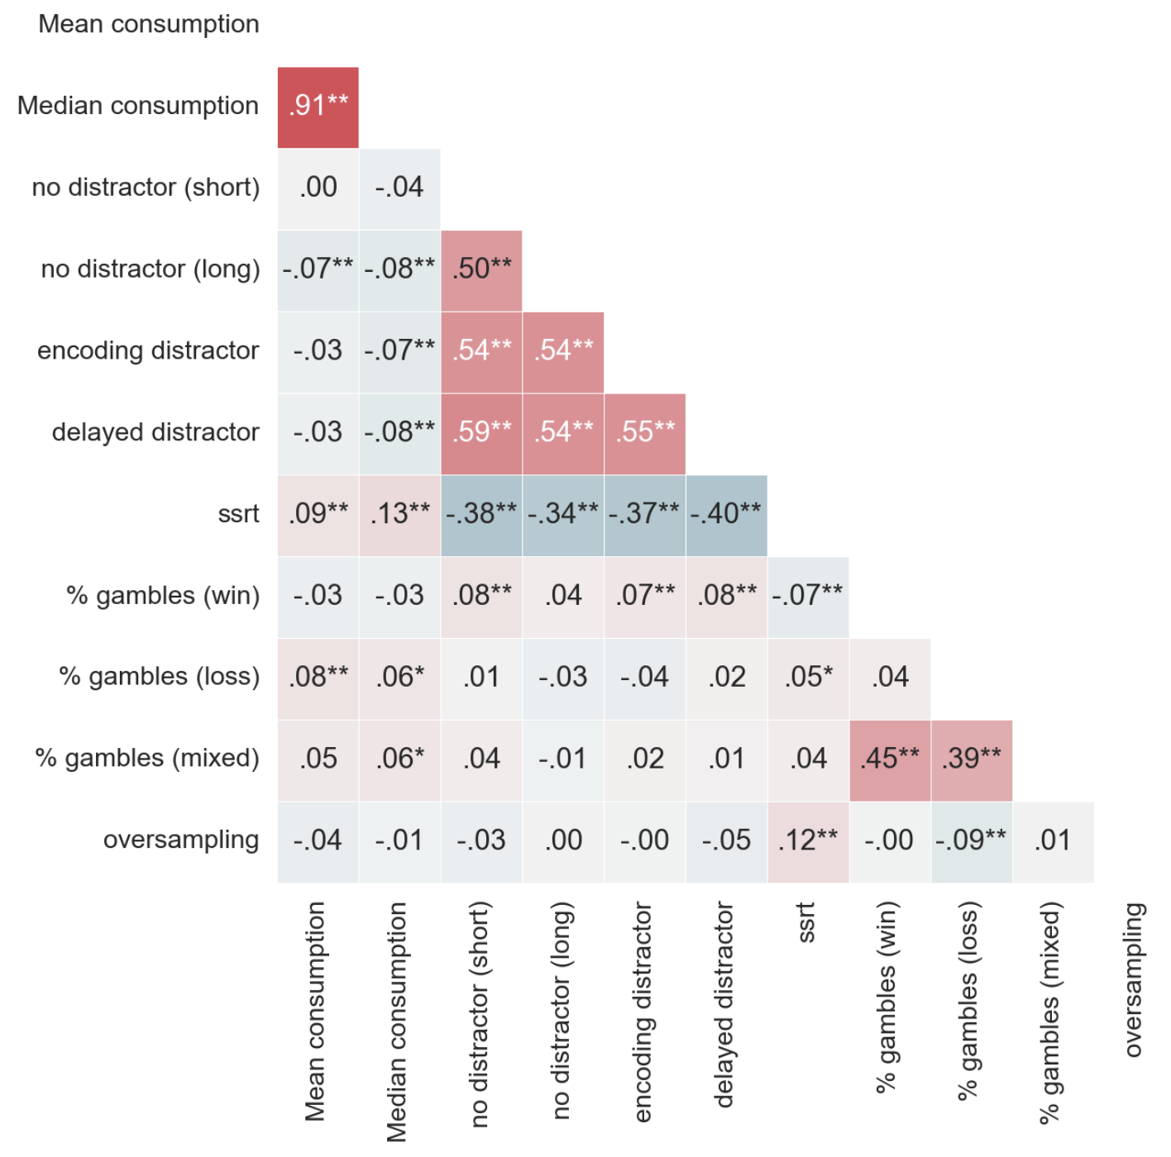
EMA drinking
Working memory
Inhibition
Risk taking
Information sampling

Slide 33
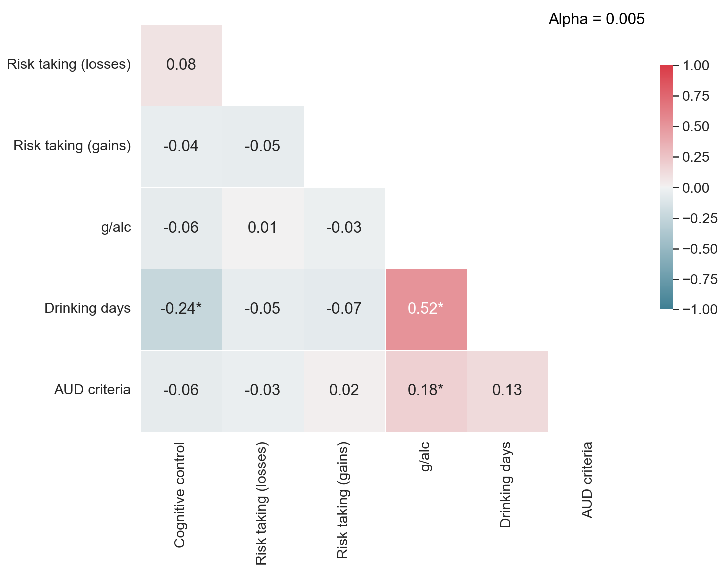

Slide 34
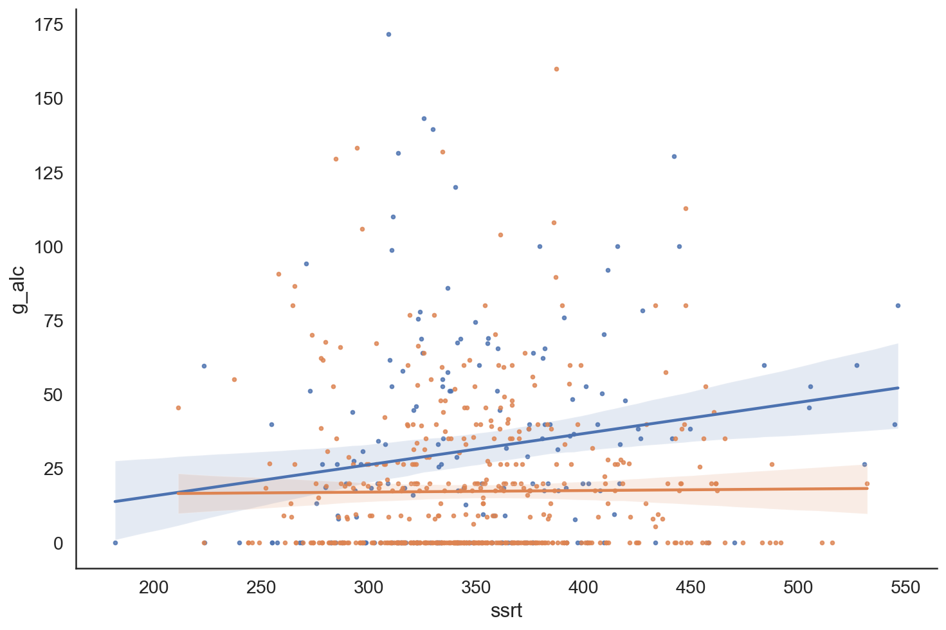
weekend
weekday
g/alc per day
SSRT

Slide 35
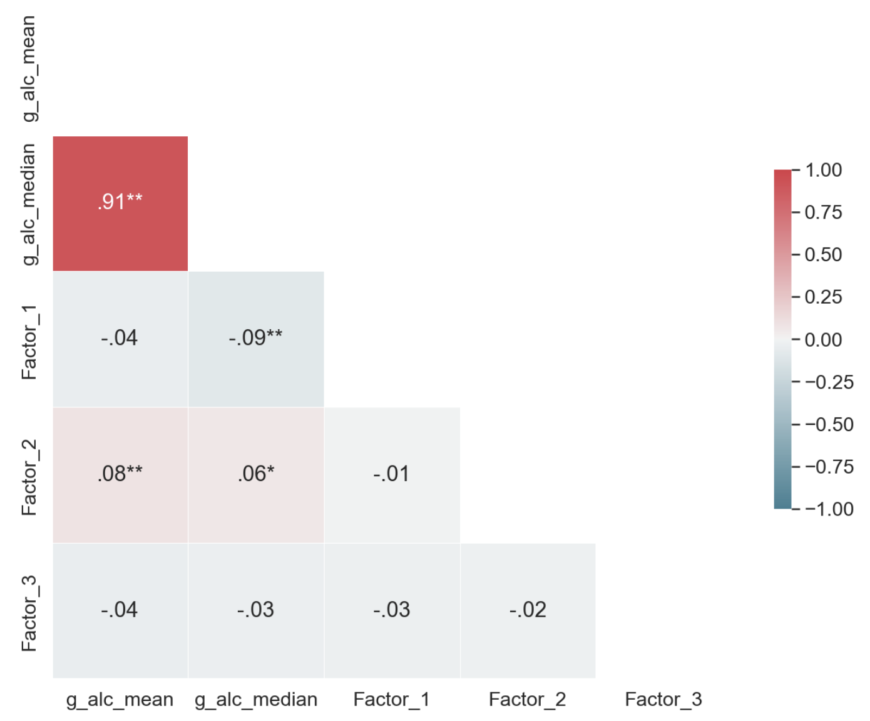
Self-regulation factors
Retrospective drinking
AUD criteria
EMA drinking

Slide 36
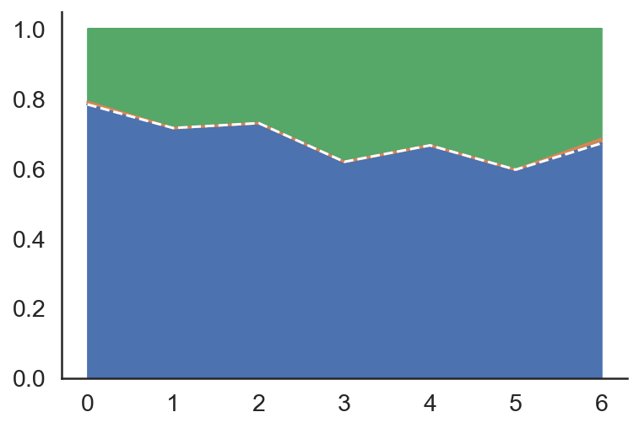
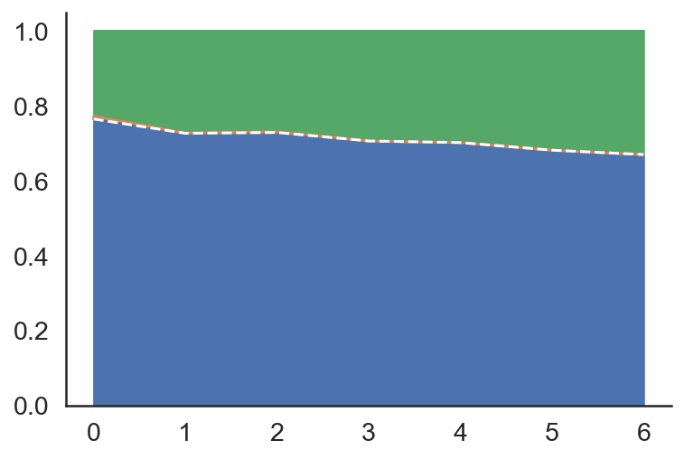
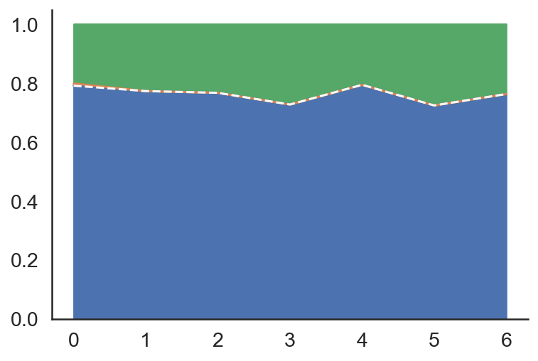
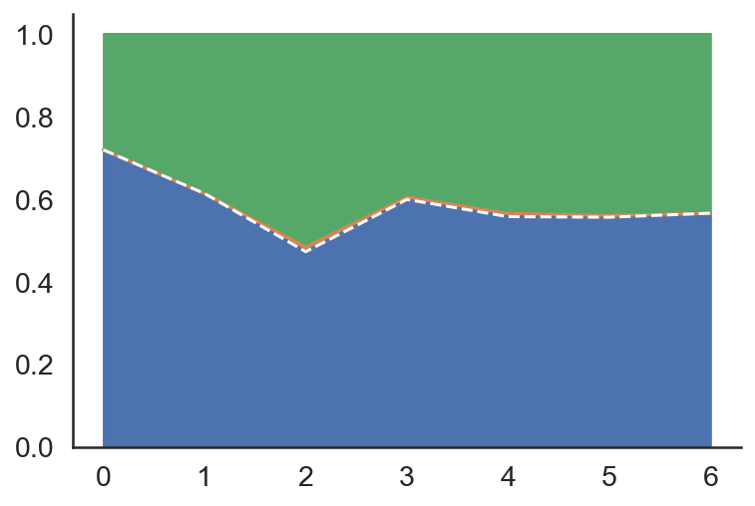
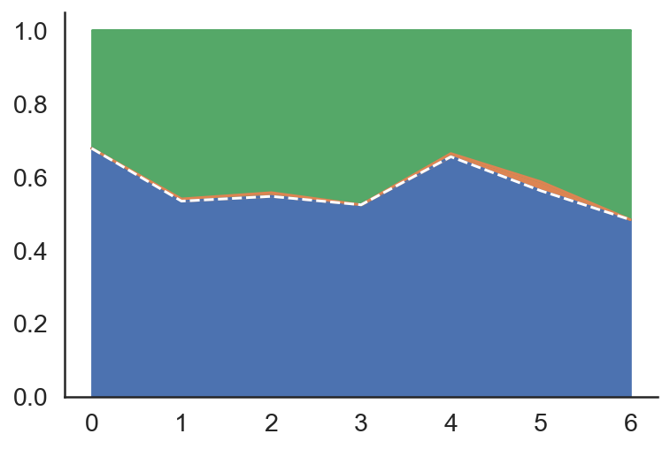
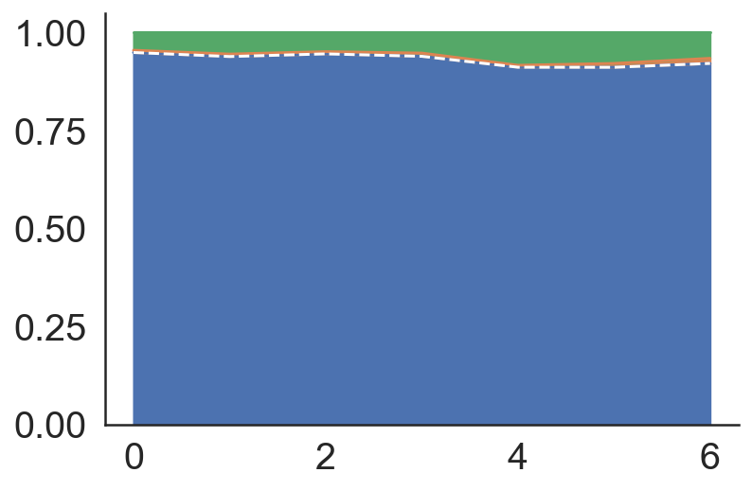
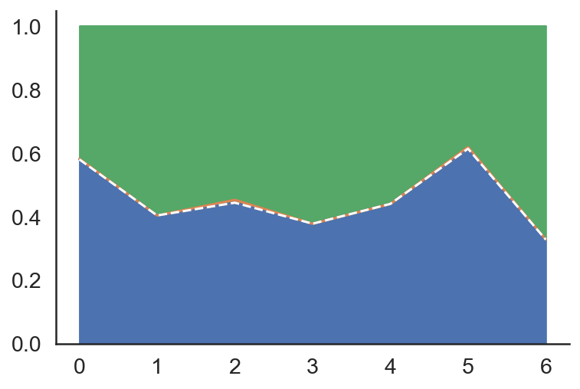
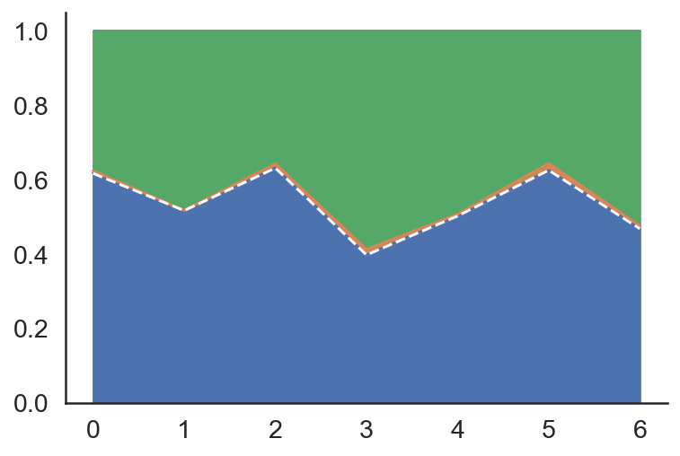
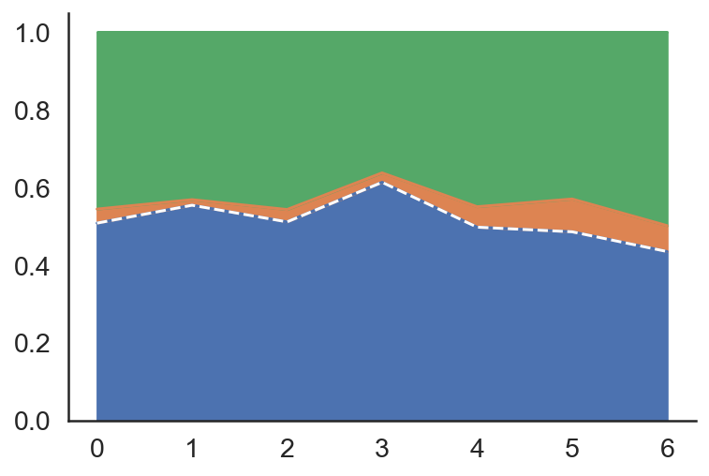
A: Risk Taking
% gambles (win)
% gambles (loss)
% gambles (mixed)
Variance
Residual
Proportion variance
Session
Participant
ICC
B: Working memory
C: Information sampling
No distractor (long)
No distractor (short)
Proportion variance
Encoding distractor
Delayed distractor
D: Response inhibition
Proportion variance
Months since first session
Months since first session
Months since first session

Slide 37
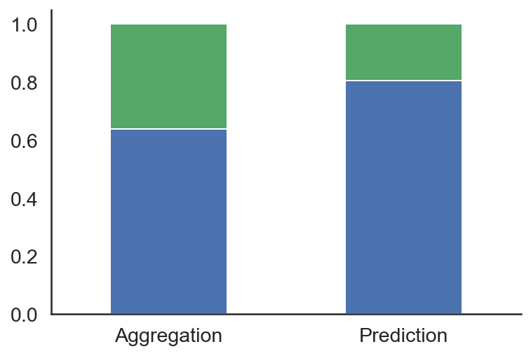
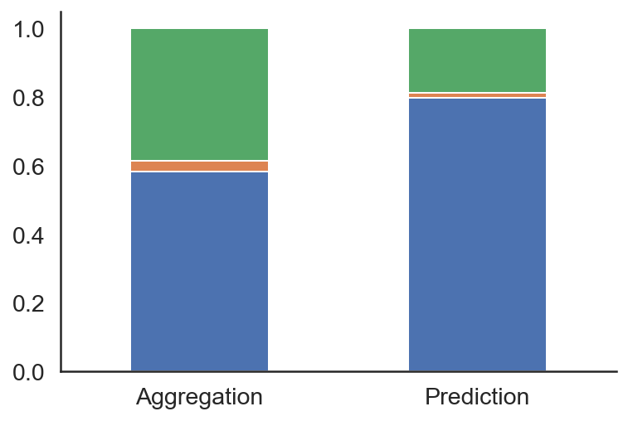
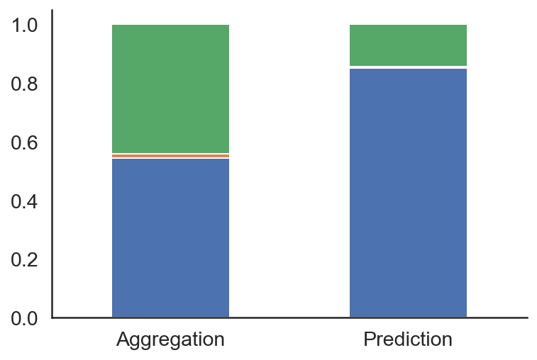
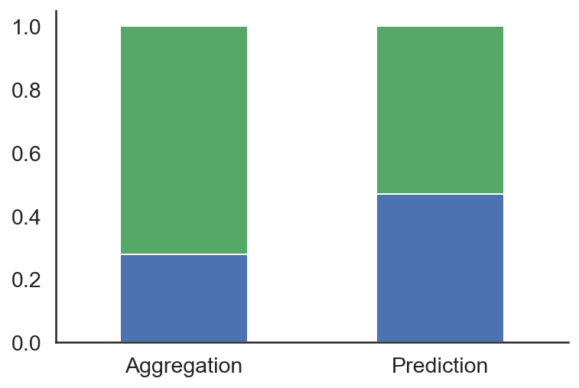
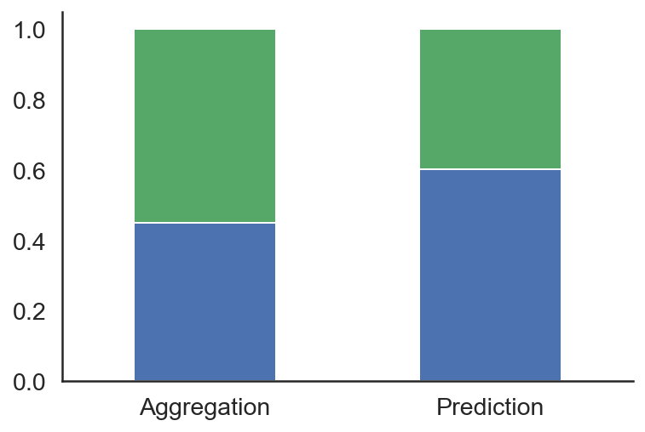
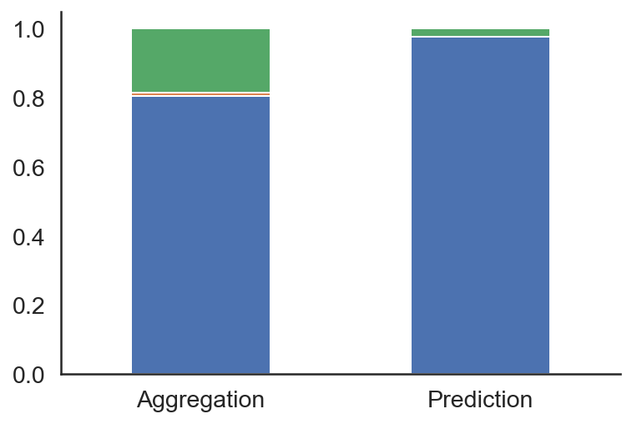
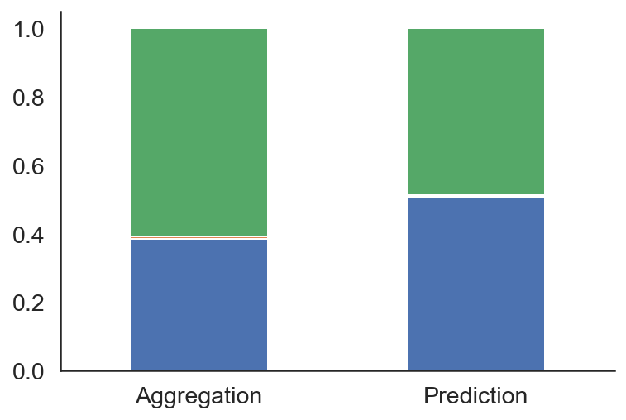
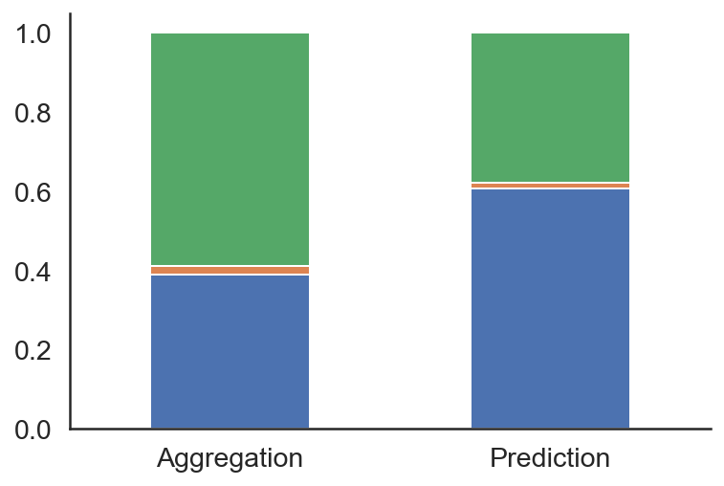
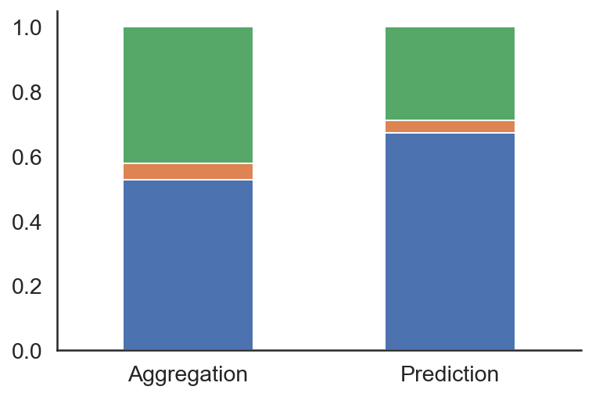
A: Risk Taking
% gambles (win)
% gambles (loss)
% gambles (mixed)
Variance
Residual
ICC
Session
Participant
B: Working memory
C: Information sampling
No distractor (long)
No distractor (short)
ICC
Encoding distractor
Delayed distractor
D: Stop signal
ICC

Slide 38
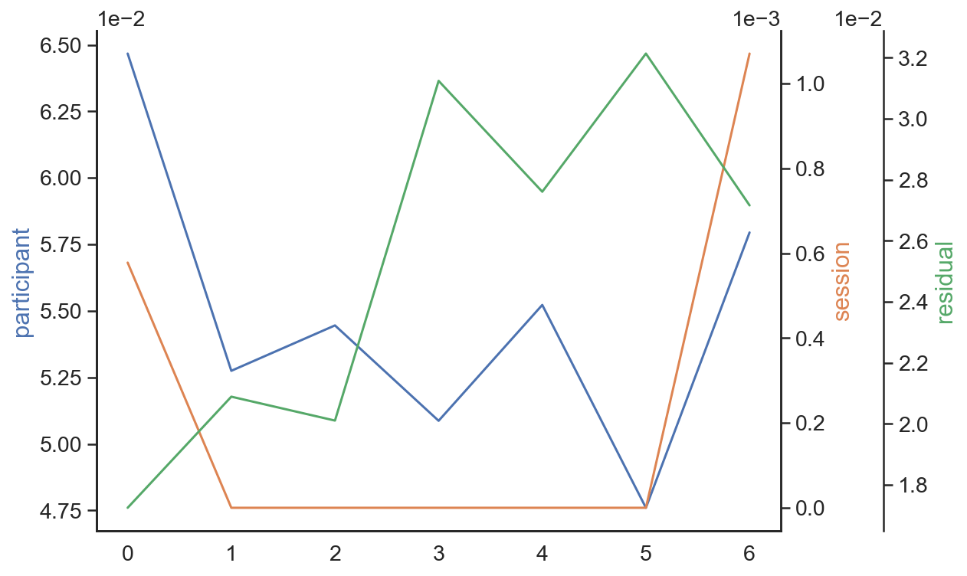
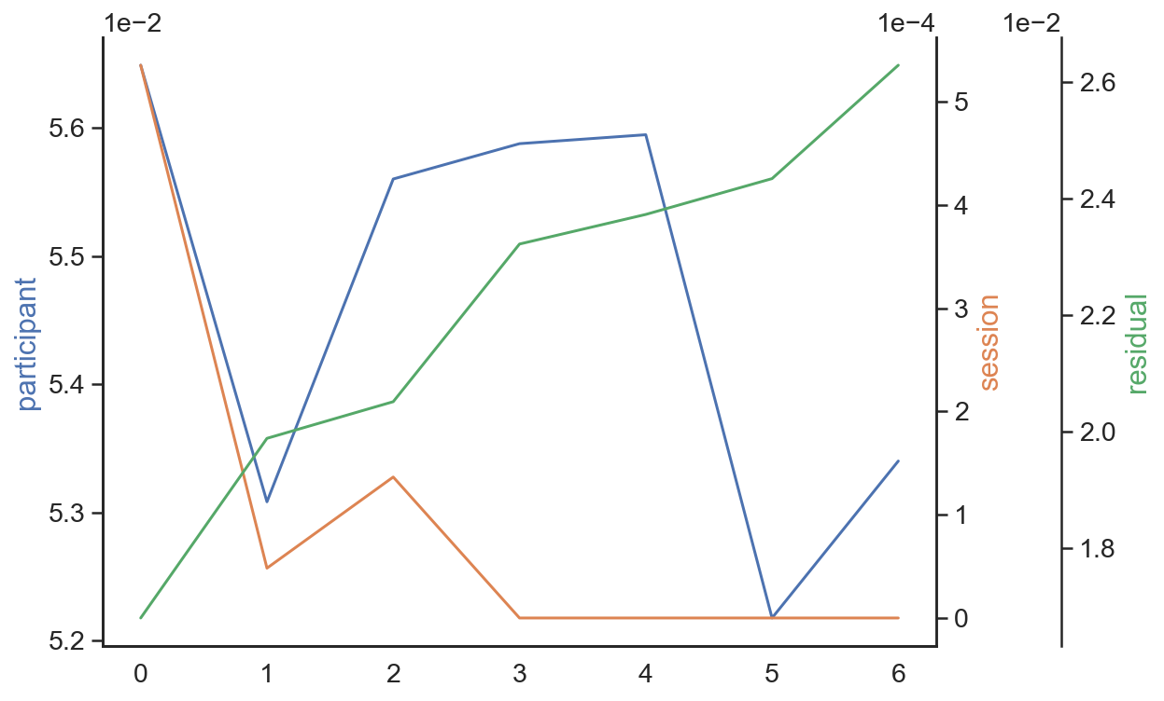
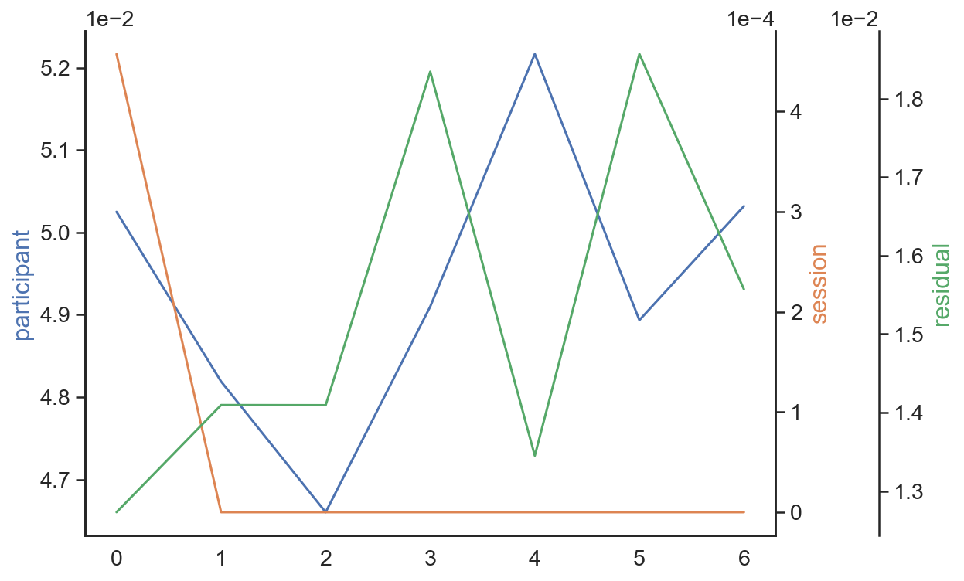
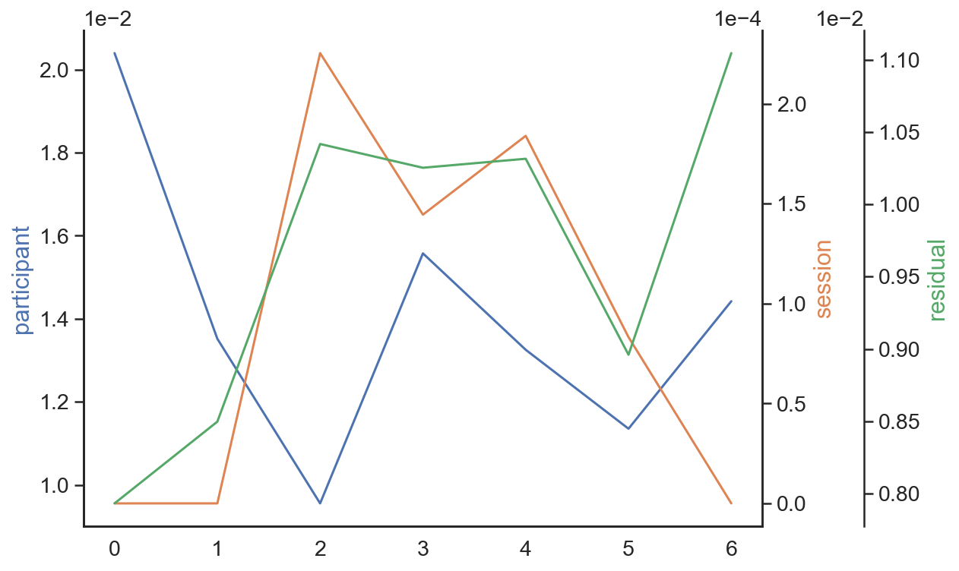
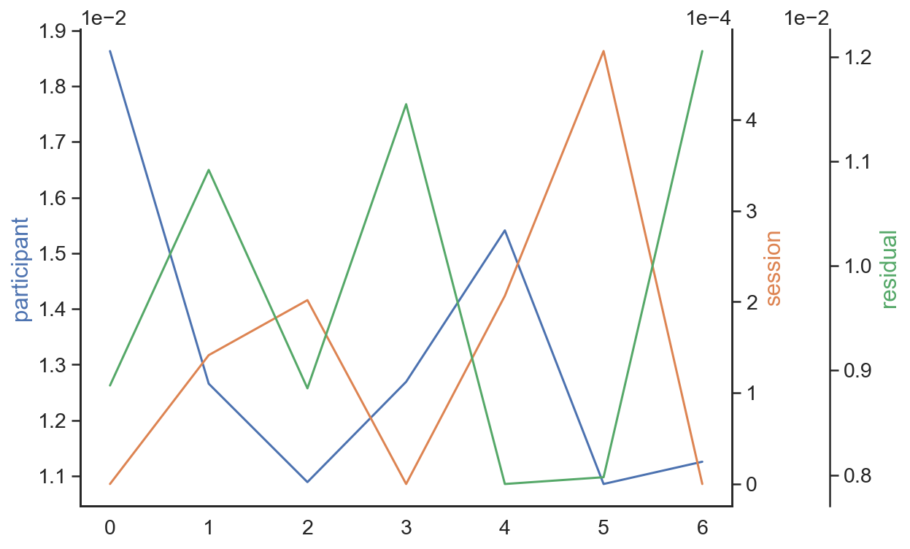
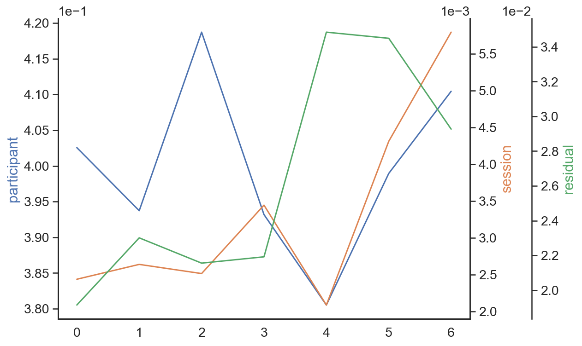



A: Risk Taking
% gambles (win)
% gambles (loss)
% gambles (mixed)
ICC
B: Working memory
C: Information sampling
No distractor (long)
No distractor (short)
ICC
Encoding distractor
Delayed distractor
D: Response inhibition
ICC
Months since first session
Months since first session
Months since first session
Notes:
Absolute variances over time.

Slide 39









A: Risk Taking
% gambles (win)
% gambles (loss)
% gambles (mixed)
ICC/
Variance change
ICC
ICC
Residual
Session
Participant
B: Working memory
C: Information sampling
No distractor (long)
No distractor (short)
ICC
Encoding distractor
Delayed distractor
D: Response inhibition
ICC
Months since first session
Months since first session
Months since first session
Notes:
Absolute variance change over time.

Slide 40



Slide 41

Beta
Model definitions:
* p < .05
For untransformed predictors (e.g., Factor_1):
outcome ~ predictor + (1 | participant)
For decomposed predictors (e.g., Factor_1_within):
outcome ~ predictor_within + predictor_between + (1 | participant)
Predictor variables
Outcome variables

Slide 42
Model definitions:
For untransformed predictors (e.g., Factor_1):
outcome ~ predictor + (1 | participant)
For decomposed predictors (e.g., Factor_1_within):
outcome ~ predictor_within + predictor_between + (1 | participant)
Beta
Predictor variables
* p < .05
Outcome variables
Notes:
"Es kam in den vergangenen 8 Tagen vor, dass ich keine Kontrolle mehr über meinen Alkoholkonsum hatte.” (VAS: “niemals" bis "immer"
("Planen Sie, Ihren Alkoholkonsum […] zu begrenze”, 0: "NEIN, ich habe keine speziellen Vorsätze”, 1: "JA, ich möchte nicht mehr als üblich trinken”, 2: "JA, ich möchte weniger als üblich trinken" )

